Slide 1
Creating a Scanner
Kyle Stanley N. Ty – CMPILER S11
(insert video from test case here)

Slide 2
Lexical Analysis
Reading of text input and creating of tokens

Slide 3
Lexical Analysis
Maximal munch algorithm implementation

Slide 4
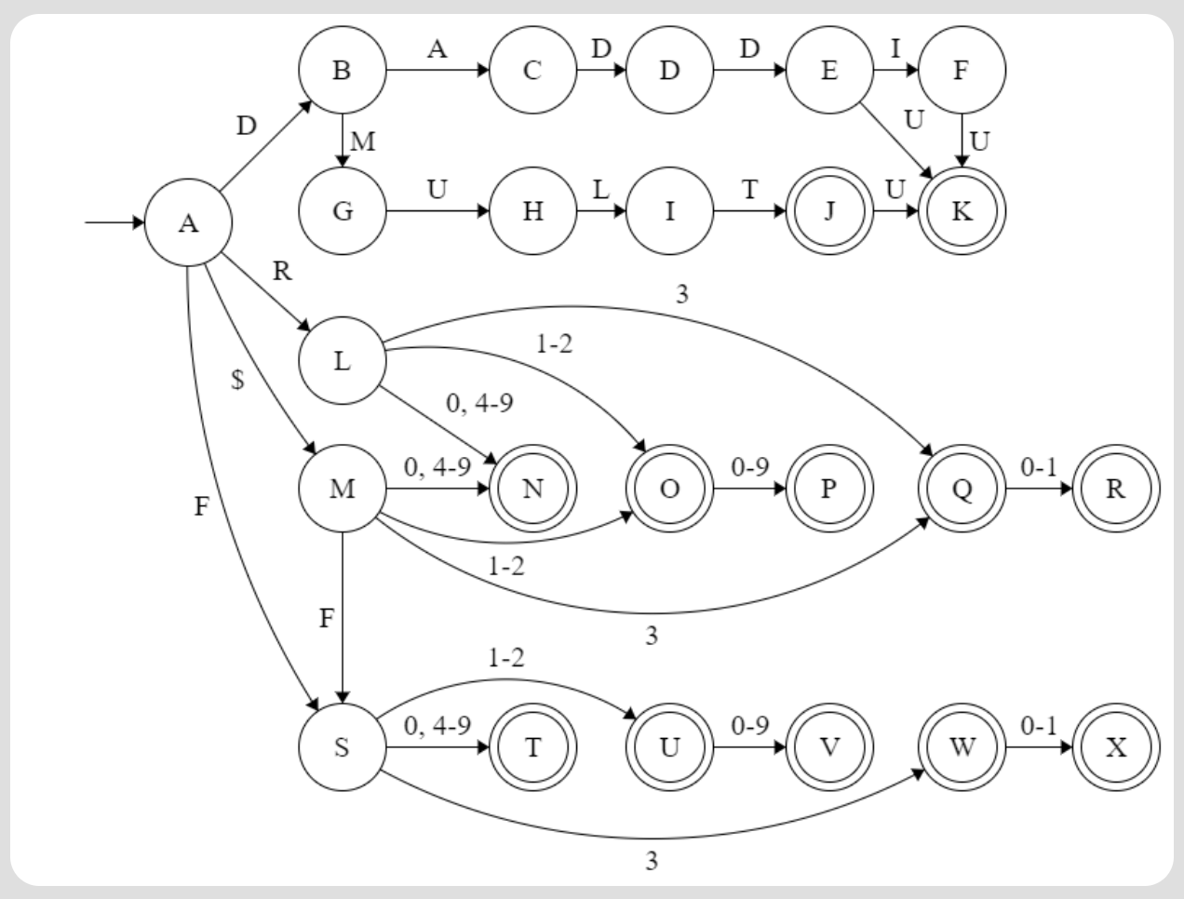
Lexical Analysis
DFA implementation

Slide 5
Lexical Analysis
Dealing with unrecognizable tokens

